Slide 1
Algorithms (CS-204)

Slide 2
Problem of finding Minimum
T(1)=0
T(n)= 1+T(n-1)
T(8)=1+T(7)=1+1+T(6)=3+T(5)=4+T(4)=7+T(1)=7=n-1
T(n) = T(n/2)+T(n-n/2)+1
T(8) =T(4)+T(4)+1 = 2(2T(2)+1)+1=4(2T(1)+1)+3=7=n-1
T(n) = O(n)

Slide 3
Problem of Searching
T(1)=1
T(n)=T(n/2)+1=T(n/4)+2=T(n/2^{i})+i
n/2^{i}=1 => i=log₂n
T(n)=T(1)+log₂n=1+log₂n = O(log₂n)

Slide 4
When splitting point matters?

Slide 5
Tower of Hanoi
There are three towers
There are n disks, with decreasing sizes, placed on the first tower
You need to move all of the disks from the first tower to the last tower
Larger disks can not be placed on top of a smaller disk
The third tower can be used to temporarily hold disks

Slide 6
Base Case
A
B
C

Slide 7
Base Case
A
B
C

Slide 8
Using Base case to solve problem with 2 disks
A
B
C

Slide 9
A
B
C

Slide 10
A
B
C

Slide 11
A
B
C

Slide 12
Using solution of 2 disks to solve problem with 3 disks
A
B
C

Slide 13
Recursive Solution
A
B
C

Slide 14
Recursive Solution
A
B
C

Slide 15
Recursive Solution
A
B
C

Slide 16
Recursive Algorithm
void Hanoi(int n, string a, string b, string c)
{
if (n == 1) /* base case */
Move(A,B);
else { /* recursion */
Hanoi(n-1,A,C,B);
Move(A,B);
Hanoi(n-1,C,B,A);
}
}

Slide 17
Induction
To prove a statement S(n) for positive integers n
Prove S(1)
Prove that if S(n) is true [inductive hypothesis] then S(n+1) is true.
This implies that S(n) is true for n=1,2,3,…

Slide 18
Correctness and Cost
Use induction to prove that the recursive algorithm solves the Tower of Hanoi problem.
The number of moves M(n) required by the algorithm to solve the n-disk problem satisfies the recurrence relation
M(n) = 2M(n-1) + 1
M(1) = 1

Slide 19
Guess and Prove
Calculate M(n) for small n and look for a pattern.
Guess the result and prove your guess correct using induction.
n | M(n)
1 | 1
2 | 3
3 | 7
4 | 15
5 | 31

Slide 20
Substitution Method
Unwind recurrence, by repeatedly replacing M(n) by the r.h.s. of the recurrence until the base case is encountered.
M(n) = 2M(n-1) + 1
= 2*[2*M(n-2)+1] + 1 = 2² * M(n-2) + 1+2
= 2² * [2*M(n-3)+1] + 1 + 2
= 2³ * M(n-3) + 1+2 + 2²

Slide 21
Geometric Series
After k steps
M(n) = 2^{k} * M(n-k) + 1+2 + 2² + … + 2^{n-k-1}
Base case encountered when k = n-1
M(n) = 2^{n-1} * M(1) + 1+2 + 2² + … + 2^{n-2}
= 1 + 2 + … + 2^{n-1} =
Use induction to reprove result for M(n) using this sum. Generalize by replacing 2 by x.

Slide 22
Merge Sort
MergeSort(arr[], l, r)
If r > l
Find the middle point to divide the array into two halves: middle m = (l+r)/2
Call mergeSort for first half: Call mergeSort(arr, l, m)
Call mergeSort for second half: Call mergeSort(arr, m+1, r)
Merge the two halves sorted in step 2 and 3: Call merge(arr, l, m, r)

Slide 23
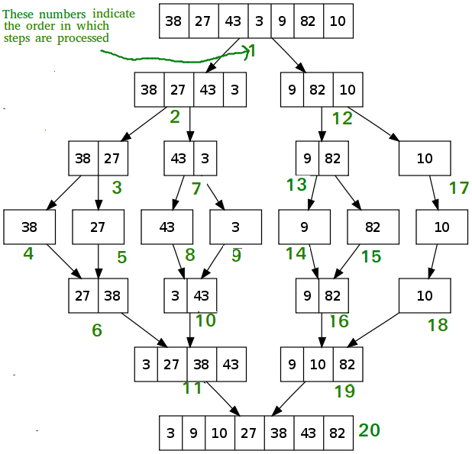

Slide 24
T(n) = 2T(n/2) + O(n) = O(nlogn)

